Slide 1

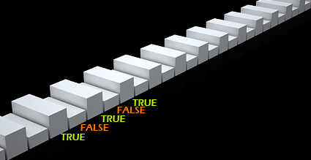


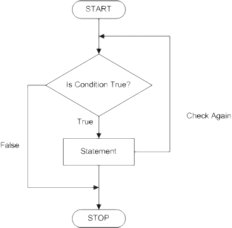
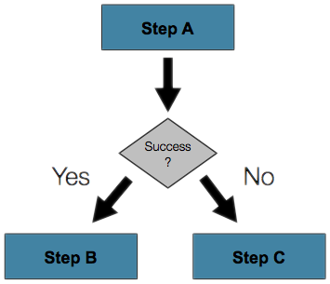
Conditional Statements
Implementing Control-Flow Logic in C#
Programming
Basics
SoftUni Team
Technical Trainers
Software University
http://softuni.bg

Slide 2

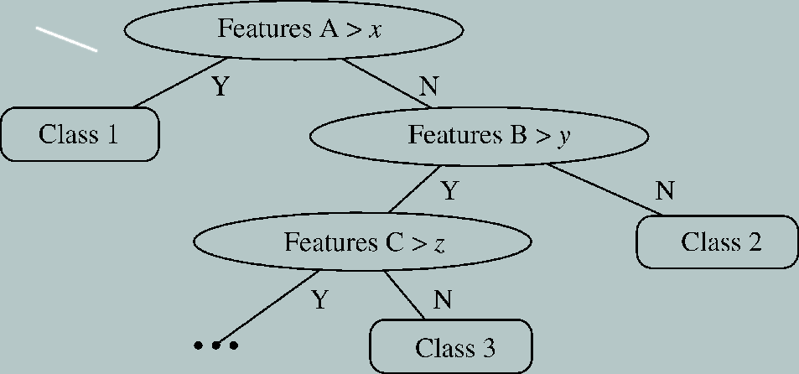
Table of Contents
Comparison and Logical Operators
The if Statement
The if-else Statement
Nested if Statements
The switch-case Statement

Slide 3

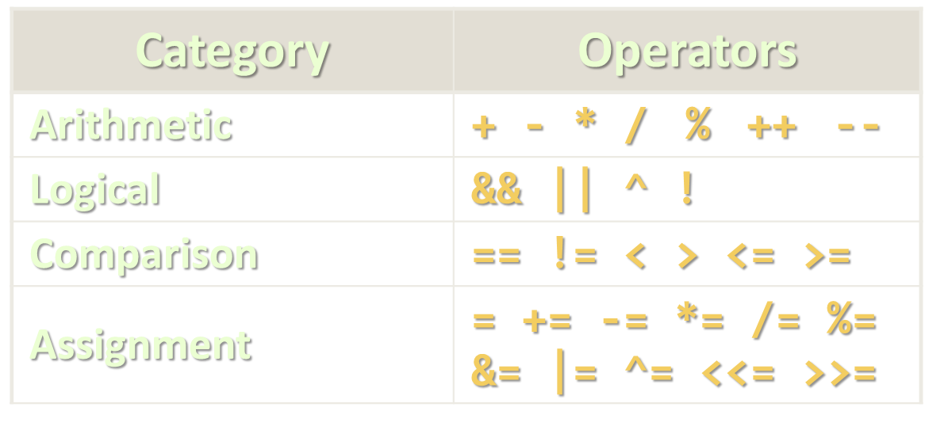
Comparison and Logical Operators

Slide 4
Comparison Operators
Operator | Notation in C# | Applicable for
Equals | == | strings / numbers / dates / most objects
Not Equals | !=
Greater Than | > | numbers / dates / comparable objects
Greater Than or Equals | >=
Less Than | <
Less Than or Equals | <=
Example:
bool result = (5 <= 6);
Console.WriteLine(result); // True

Slide 5

Logical Operators
Operator | Notation in C# | Example
Logical NOT | ! | !false → true
Logical AND | && | true && true → true
Logical OR | || | true || false → true
Logical Exclusive OR (XOR) | ^ | true ^ false → true
De Morgan laws
!!A ⬄ A
!(A || B) ⬄ !A && !B
!(A && B) ⬄ !A || !B

Slide 6

if and if-else
Implementing Conditional Logic

Slide 7
The if Statement
The simplest conditional statement
Enables you to test for a condition
Branch to different blocks in the code depending on the result
The simplest form of the if statement:
if (condition)
{
statements;
}

Slide 8

Condition and Statement
The condition can be:
Boolean variable
Boolean logical expression
Comparison expression
The condition cannot be integer variable (like in C / C++)
The statement can be:
Single statement ending with a semicolon
Block enclosed in curly braces

Slide 9
How It Works?
The condition is evaluated
If it is true, the statement is executed
If it is false, the statement is skipped
condition
false
true
statements

Slide 10
The if Statement – Example
static void Main()
{
Console.WriteLine("Enter two numbers.");
int biggerNum = int.Parse(Console.ReadLine());
int smallerNum = int.Parse(Console.ReadLine());
if (smallerNum > biggerNum)
{
biggerNum = smallerNum;
}
Console.WriteLine("The greater number is: {0}", biggerNum);
}

Slide 11

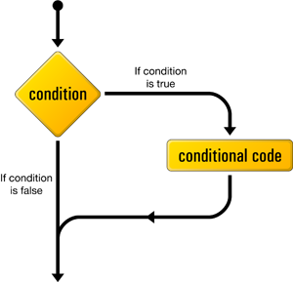
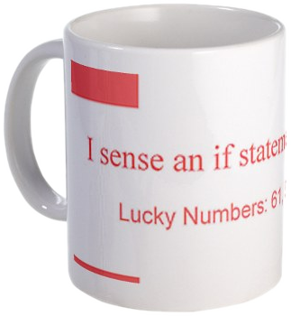
The if Statement
Live Demo

Slide 12
The if-else Statement
More complex and useful conditional statement
Executes one branch if the condition is true, and another if it is false
The simplest form of an if-else statement:
if (expression)
{
some_statement;
}
else
{
another_statement;
}

Slide 13
How It Works?
The condition is evaluated
If it is true, the first statement is executed
If it is false, the second statement is executed
condition
false
second
statement
true
first
statement

Slide 14
if-else Statement – Example
Checking a number if it is odd or even
string s = Console.ReadLine();
int number = int.Parse(s);
if (number % 2 == 0)
{
Console.WriteLine("This number is even.");
}
else
{
Console.WriteLine("This number is odd.");
}

Slide 15
The if-else Statement
Live Demo

Slide 16
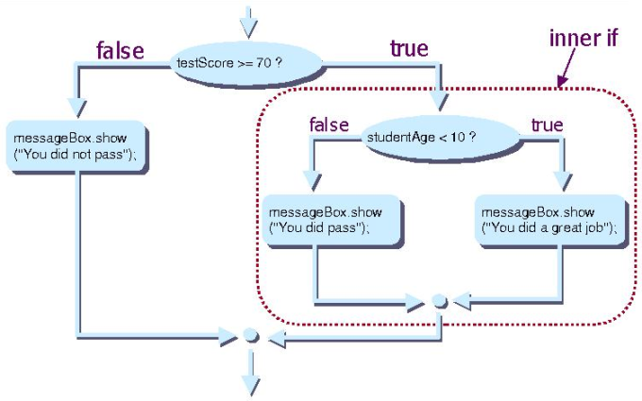
Nested if Statements
Creating More Complex Logic

Slide 17
Nested if Statements
if and if-else statements can be nested
Used inside one inside another
Each else corresponds to its closest preceding if
if (expression)
{
if (expression)
some_statement;
else
another_statement;
}
else
third_statement;

Slide 18
Nested if – Good Practices
Always use { … } blocks to avoid ambiguity
Even when a single statement follows
Avoid using more than three levels of nested if statements
Put the case you normally expect to process first
Then write the unusual cases
Arrange the code to make it more readable

Slide 19
Nested if Statements – Example
if (first == second)
{
Console.WriteLine("These two numbers are equal.");
}
else
{
if (first > second)
{
Console.WriteLine("The first number is bigger.");
}
else
{
Console.WriteLine("The second is bigger.");
}
}

Slide 20
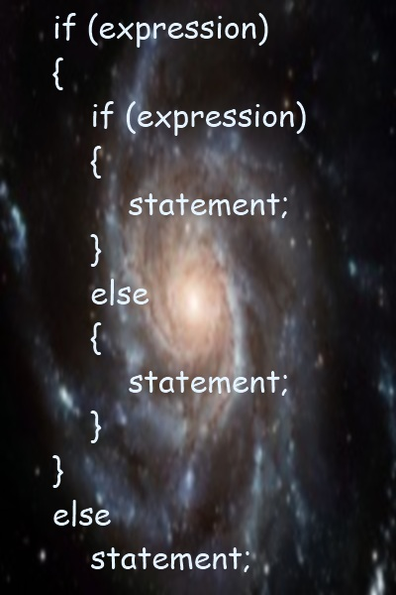
Nested if Statements
Live Demo

Slide 21
Multiple if-else-if-else-…
We may need to use another if-construction in the else block
Thus else if can be used:
int ch = 'X';
if (ch == 'A' || ch == 'a')
{
Console.WriteLine("Vowel [ei]");
}
else if (ch == 'E' || ch == 'e')
{
Console.WriteLine("Vowel [i:]");
}
else if …
else …

Slide 22
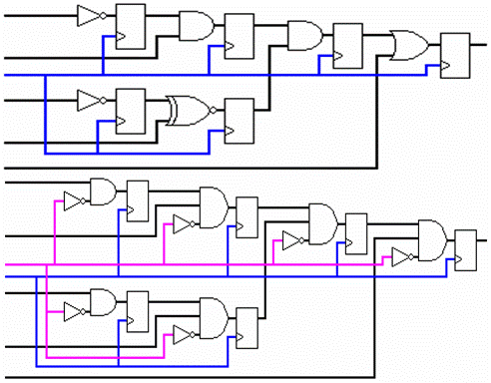
Multiple if-else Statements
Live Demo

Slide 23

switch-case
Performing Several Comparisons at Once

Slide 24
The switch-case Statement
Selects for execution a statement from a list depending on the value of the switch expression
switch (day)
{
case 1: Console.WriteLine("Monday"); break;
case 2: Console.WriteLine("Tuesday"); break;
case 3: Console.WriteLine("Wednesday"); break;
case 4: Console.WriteLine("Thursday"); break;
case 5: Console.WriteLine("Friday"); break;
case 6: Console.WriteLine("Saturday"); break;
case 7: Console.WriteLine("Sunday"); break;
default: Console.WriteLine("Error!"); break;
}

Slide 25
How switch-case Works?
The expression is evaluated
When one of the constants specified in a case label is equal to the expression
The statement that corresponds to that case is executed
If no case is equal to the expression
If there is default case, it is executed
Otherwise the control is transferred to the end point of the switch statement

Slide 26

The switch-case Statement
Live Demo

Slide 27
Using switch: Rules
Variable types like string, enum and integral types can be used for switch expression
The value null is permitted as a case label constant
The keyword break exits the switch statement
"No fall through" rule
You are obligated to use break after each case
Multiple labels that correspond to the same statement are permitted

Slide 28
Multiple Labels – Example
Multiple labels allow matching several cases and executing the same statement in more than one case
switch (animal)
{
case "dog":
Console.WriteLine("MAMMAL");
break;
case "crocodile":
case "tortoise":
case "snake":
Console.WriteLine("REPTILE");
break;
default:
Console.WriteLine("I don't know such animal!");
break;
}

Slide 29

Multiple Labels in a switch-case
Live Demo

Slide 30
Using switch – Good Practices
There must be a separate case for every normal situation
Put the normal case first
Put the most frequently executed cases first and the least frequently executed last
Order cases alphabetically or numerically
In default use case that cannot be reached under normal circumstances

Slide 31
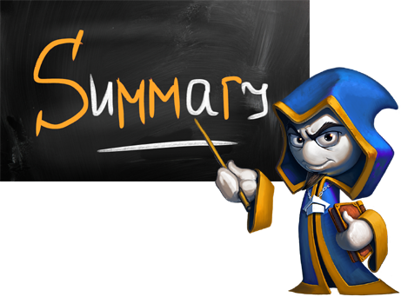
Summary
Comparison and logical operators are used to compose logical conditions
The conditional statements if and if-else conditionally execution of blocks of code
Constantly used in computer programming
Conditional statements can be nested
The switch statement easily and elegantly checks an expression for a sequence of values

Slide 32








Conditional Statements
https://softuni.bg/courses/programming-basics/

Slide 33
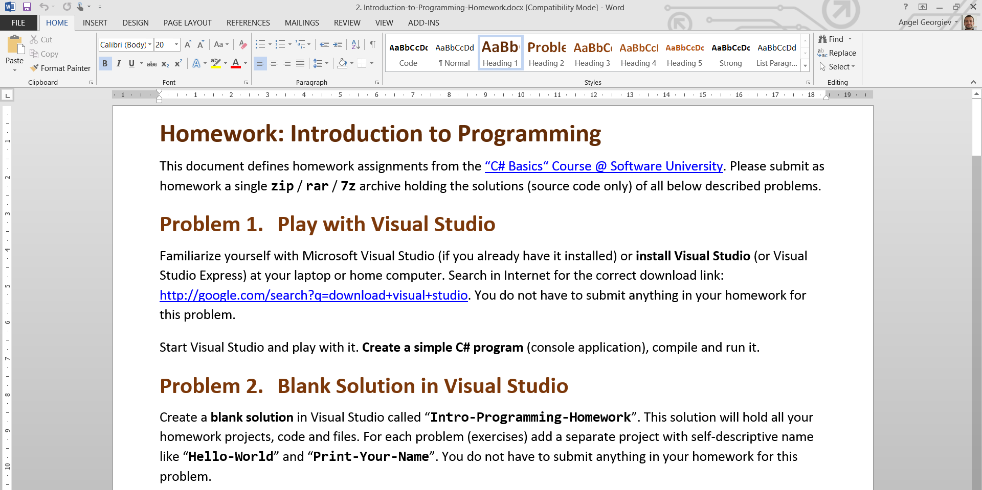
Homework Review
Live Demo

Slide 34
License
This course (slides, examples, demos, videos, homework, etc.) is licensed under the "Creative Commons Attribution-NonCommercial-ShareAlike 4.0 International" license
Attribution: this work may contain portions from
"Fundamentals of Computer Programming with C#" book by Svetlin Nakov & Co. under CC-BY-SA license
"C# Part I" course by Telerik Academy under CC-BY-NC-SA license

Slide 35






Free Trainings @ Software University
Software University Foundation – softuni.org
Software University – High-Quality Education, Profession and Job for Software Developers
softuni.bg
Software University @ Facebook
facebook.com/SoftwareUniversity
Software University @ YouTube
youtube.com/SoftwareUniversity
Software University Forums – forum.softuni.bg

